Slide 1
Decorators in Python
By Dr Shantanu Pathak

Slide 2
Decorators
decorators wrap a function, modifying its behavior.
functionalities can be added before or after execution of the function
Can be used for pre-requisite checks on parameters
Ex. Can help avoid errors due to wrong type of inputs
Check user login session is active, before executing a code

Slide 3
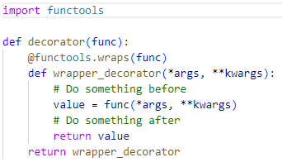
Decorator Creation Template
Now @decorator is a valid decorator in python

Slide 4
Decorator Creation Template
Explanation
A valid Decorator a higher order function ( decorator in our example)
It takes user defined function as argument ( func in our example)
functools.wraps is used to have right doc string when help() is used to find doc string of user defined function
Inside decorator we create an inner function ‘wrapper_decorator’ which will add extra code before and after the user defined function call
‘wrapper_decorator’ takes *arg and **kwarg arguments.
Means it can accept any type of arguments and any number of arguments
Then inside ‘wrapper_decorator’ function, user defined function is called using arg and kwarg parameters.
Returned value from the user defined function is captured in a variable
Then processing which needs to be done after call of the function, is performed
Then ‘wrapper_decorator’ function returns value given by user defined function.
This complete ‘wrapper_decorator’ function is returned by the decorator

Slide 5
Extra
Decorators on classes
There can be decorator functions which wrap a class
Ex. Decorator to create a singleton class
Several decorators on one function
Decorators with arguments
Decorators that can optionally take arguments
Stateful decorators
Classes as decorators
Further reading : https://realpython.com/primer-on-python-decorators/
https://stackoverflow.com/questions/739654/how-do-i-make-function-decorators-and-chain-them-together

